Slide 1
WIRELESS INTRUSION PREVENTION SYSTEM
MODULE 2

Slide 2
INTRODUCTION
Recently, most use of wireless networks, network security has become more important than ever before. Therefore, understanding and deploying effective wireless network protection measures have become crucial.

Slide 3
WIPS security solution is designed to monitor, protect, and prevent malicious attacks and threats to wireless networks. Additionally, WIPS focuses on monitoring and responding to abnormal activities in wireless networks.

Slide 4
WIPS security solution is designed to monitor, protect, and prevent malicious attacks and threats to wireless networks. Additionally, WIPS focuses on monitoring and responding to abnormal activities in wireless networks.

Slide 5
How does WIPS work?
WIPS ensures the security of wireless networks through a series of advanced technologies:-
Network Monitoring
Wireless Device Classification
Threat Detection
Defense and Response
Data Analysis and Reporting
Automation and Integration
Policy Management and Updates
Location Tracking

Slide 6
What Threats Can WIPS Defend Against?
WIPS has various threat defense strategies and can defend against, but not limited to, the following threats:
Unauthorized Access Points
Malicious Attacks and Network Penetration
Illegal Associations and Bandwidth Abuse
Data Leak Prevention
Authentication and Encryption Vulnerabilities
Unsafe Configurations
Software Vulnerabilities and Configuration Errors

Slide 7
CONTT..
Client Risks
Evil Twin Attack
Rogue Access Point
De-authentication Attack

Slide 8
CONTT..
WIPS provides an additional layer of protection, helping to ensure the security of the network environment and guarantee data protection.
Security Enhancement-
Network Performance
Reduced Business Disruptions
Ease of Management

Slide 9
HONEYPOT-
A cyber honeypot works as by baiting a trap for hackers.
It's a sacrificial computer system that’s intended to attract cyber-attacks.
It mimics a target for hackers, and uses their intrusion attempts to gain information about cybercriminals and the way they are operating or to distract them from other targets.
Often, an enemy spy is compromised by a honey trap and then forced to hand over everything he/she knows.

Slide 10
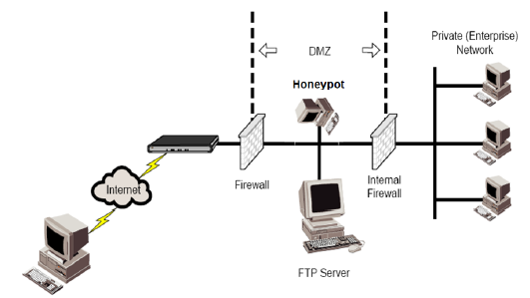
Honeypot
A honeypot is a computer typically located in a DMZ that is loaded with software and data files that appear to be authentic, yet they are actually imitations of real data files.

Slide 11
How it works?
The honeypot looks like a real computer system, with applications and data, fooling cybercriminals into thinking it's a legitimate target.
For example, a honeypot could mimic a company's customer billing system - a frequent target of attack for criminals who want to find credit card numbers.
Once the hackers are in, they can be tracked, and their behavior assessed for clues on how to make the real network more secure.

Slide 12
Honeypots are made attractive to attackers by building in deliberate security vulnerabilities.
For instance, a honeypot might have ports that respond to a port scan or weak passwords.
Vulnerable ports might be left open to entice attackers into the honeypot environment, rather than the more secure live network.

Slide 13
CONTT..
With the intelligence obtained from a honeypot, security efforts can be prioritized and focused.

Slide 14
TYPES OF HONEYPOT
Email traps or spam traps place a fake email address in a hidden location where only an automated address harvester will be able to find it.
Since the address isn't used for any purpose other than the spam trap, it's 100% certain that any mail coming to it is spam.
All messages which contain the same content as those sent to the spam trap can be automatically blocked, and the source IP of the senders can be added to a denylist.

Slide 15
CONTT..
A decoy database can be set up to monitor software vulnerabilities and spot attacks exploiting insecure system architecture or using SQL injection, SQL services exploitation, or privilege abuse.
A malware honeypot mimics software apps and APIs to invite malware attacks.
The characteristics of the malware can then be analyzed to develop anti-malware software or to close vulnerabilities in the API.

Slide 16
CONTT..
A spider honeypot is intended to trap web-crawlers ('spiders') by creating web pages and links only accessible to crawlers.
Detecting crawlers can help you learn how to block malicious bots, as well as ad-network crawlers.

Slide 17
By monitoring traffic coming into the honeypot system, you can assess:
where the cybercriminals are coming from
the level of threat
what modus operandi they are using
what data or applications they are interested in
how well your security measures are working to stop cyber-attacks

Slide 18
DANGERS OF HONEYPOTS
If an attacker manages to identify it as a honeypot, they can then proceed to attack your other systems while leaving the honeypot untouched.
an attacker can create spoofed attacks to distract attention from a real exploit being targeted against your production systems. They can also feed bad information to the honeypot.

